Slide 1
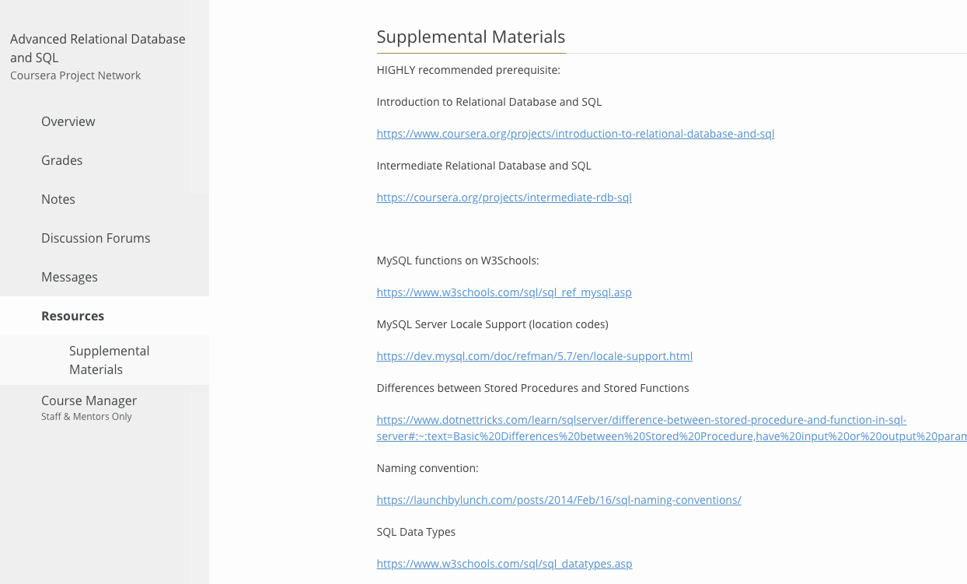
ADVANCED RDB and SQL
Welcome!!

Slide 2

ADVANCED RDB and SQL
Topics
Server Functions
Common Table Expression (CTE)
Stored Functions
CTE Recursive
Stored Procedures
Triggers
Icons made by Smashicons from www.flaticon.com

Slide 3
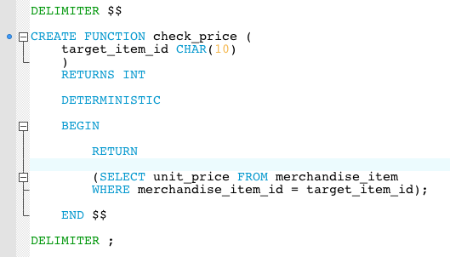
Stored Function
function name
parameters
return type
Deterministic or not
definition

Slide 4
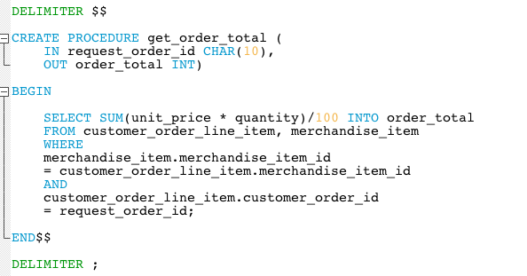
Stored Procedures
procedure name
parameters
set output
definition

Slide 5
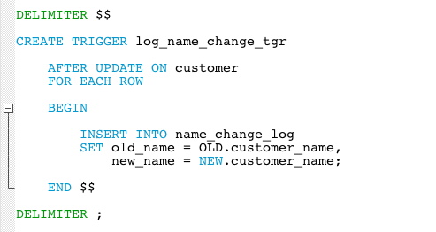
Triggers
trigger name
triggering event
AFTER INSERT
AFTER UPDATE
AFTER DELETE
BEFORE INSERT
BEFORE UPDATE
BEFORE DELETE
always
triggering table
actions
OLD and NEW
Values of affected columns

Slide 6
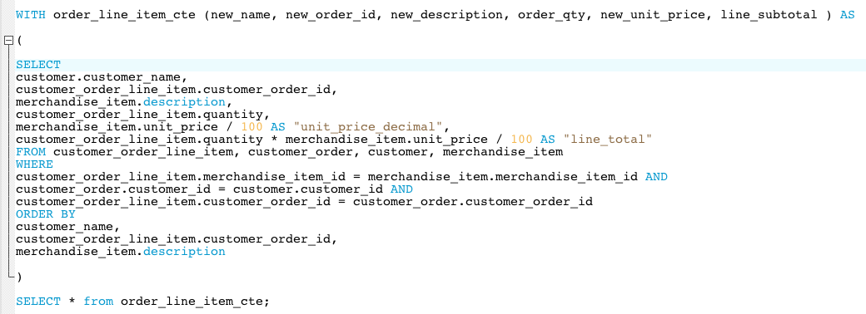
Common Table Expression
CTE name
column names
number of columns
must agree
and they correspond
definition
use as if it’s a read-only table

Slide 7
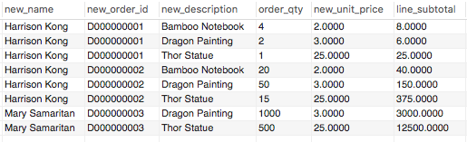
Common Table Expression
column names
number of columns
must agree
and they correspond

Slide 8
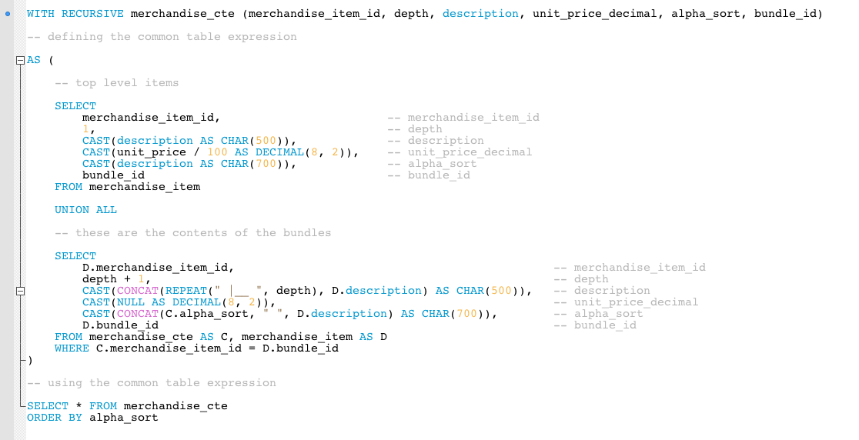
CTE Recursive
column names
anchor
same number
rows from all the results set
are combined!
calls itself !!
recursive
stop condition

Slide 9
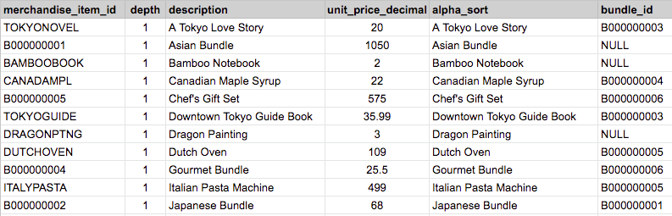
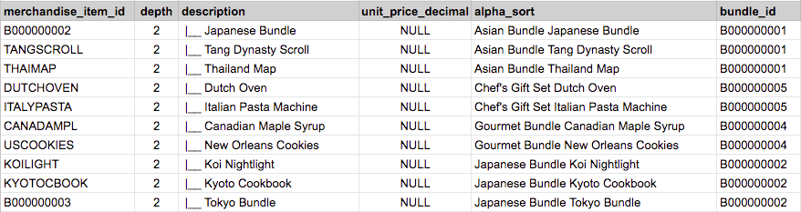
CTE Recursive - iteration 1
anchor query
recursive query

Slide 10
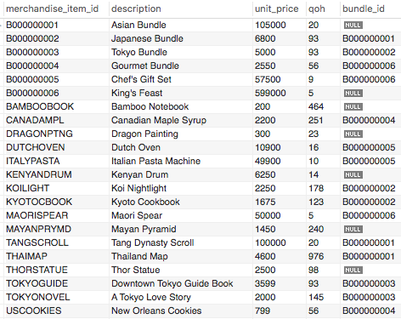
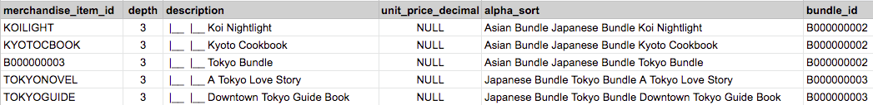
CTE Recursive - iteration 2
from recursive iteration 1
merchandise_item

Slide 11
CTE Recursive - iteration 3
from recursive iteration 2
merchandise_item

Slide 12
CTE Recursive - iteration 4
from recursive iteration 3
merchandise_item
No match =
Stop condition met

Slide 13
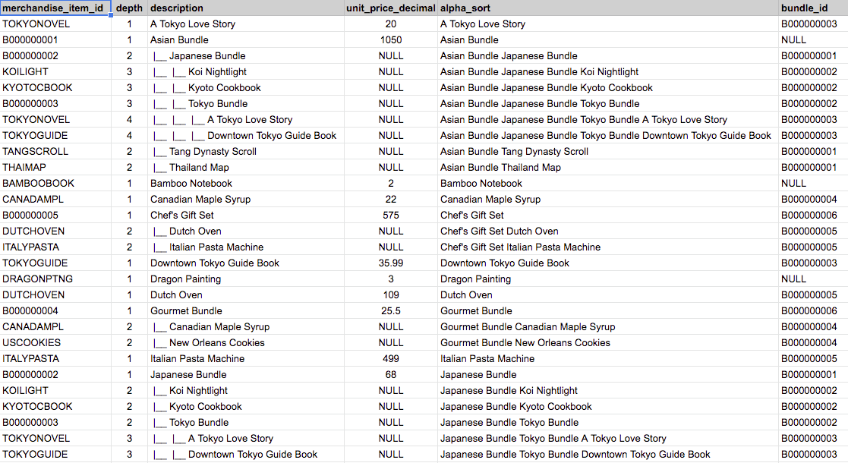
CTE Recursive - Final Union All
UNION ALL

Slide 14

CTE Recursive - Web App View

